Slide 1
Securing IT Networks
Understanding the trends and threats
Delivered on behalf of
Information Systems Security Association Philippines Chapter, Inc.
Rodel Urani STRATEGICT COMPANY
Senior Consultant We deliver, you use IT

Slide 2
Of importance
Planning & design

Slide 3
Internet Protocol (IP) severe cases
NATO
New threats, cannot be met by lining up tanks and soldiers
Address at its roots the cyberspace
DHS
National Cybersecurity Awareness Campaign Challenge

Slide 4
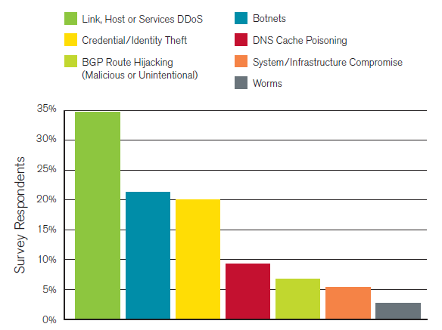
Largest anticipated attacks next 12 mos
Source: Arbor Networks, Worldwide Infrastructure Security Report 2009

Slide 5
WISR 2008
ISP’s security battlefront
DoS – last three years
2008
DNS spoofing
BGP hijacking
Spam

Slide 6
Darknet sensors
CAIDA – Cooperative Association for Internet Data Analysis
Collaborative undertaking among organizations in commercial, research and government
Based - UCSD Supercomputer Center
Funding - DHS, NSF, Cisco, WIDE Japan
ATLAS – Active Threat Level Analysis System
Arbor Networks
Collaborative effort with 100+ ISP’s and distributed globally across in 17 countries

Slide 7
ATLAS data sources
Honeypot-captured payloads
IDS logs
Scan logs
Internet DoS statistics
News & vulnerability reports
Captured malware samples
Phishing infrastructure data
Botnet command & control data

Slide 8
ATLAS Notice and Attribution ff data use
This information was obtained from Arbor Networks' ATLAS Initiative on 7 March 2010 and permission to republish has been obtained. ATLAS initiative data is dynamic and therefore, the information may have changed since the date of publication of the data.
© Arbor Networks, Inc. ALL RIGHTS RESERVED. Atlas is a trademark of Arbor Networks, Inc.

Slide 9
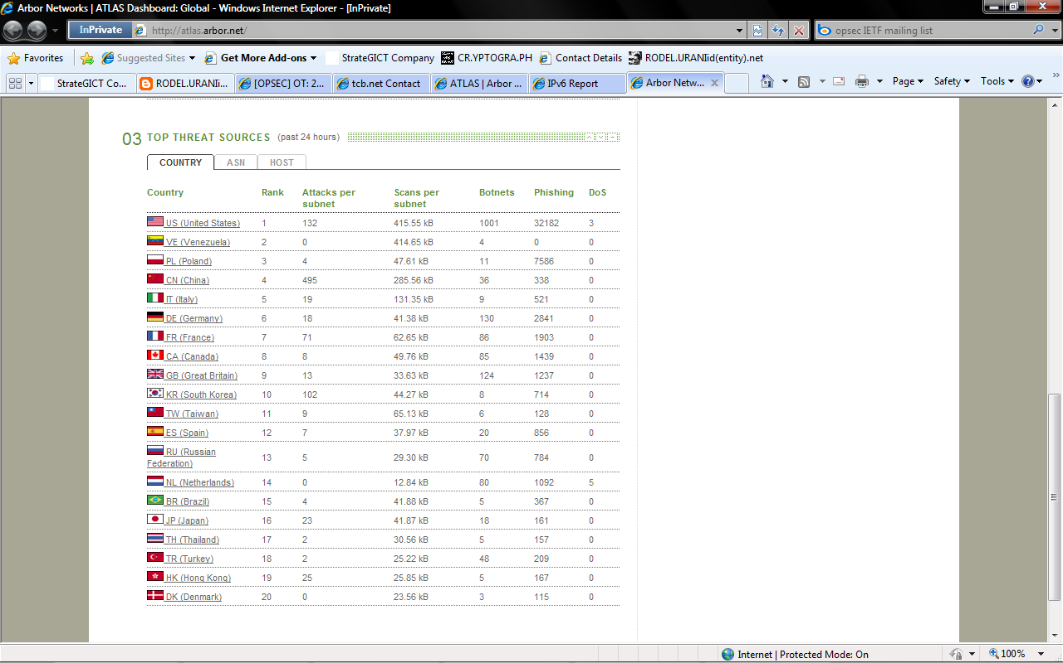
Top threat sources
Source: Arbor Networks Atlas Global Dashboard captured 7 Mar 2010 6:50A

Slide 10
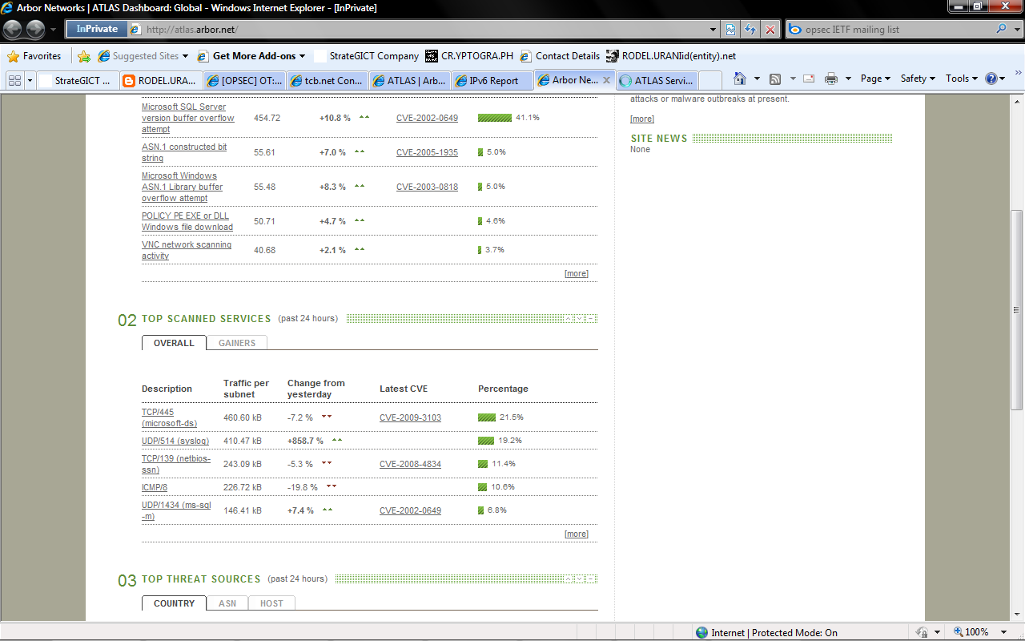
Top scanned services
Source: Arbor Networks Atlas Global Dashboard captured 7 Mar 2010 6:50A
See Description

Slide 11
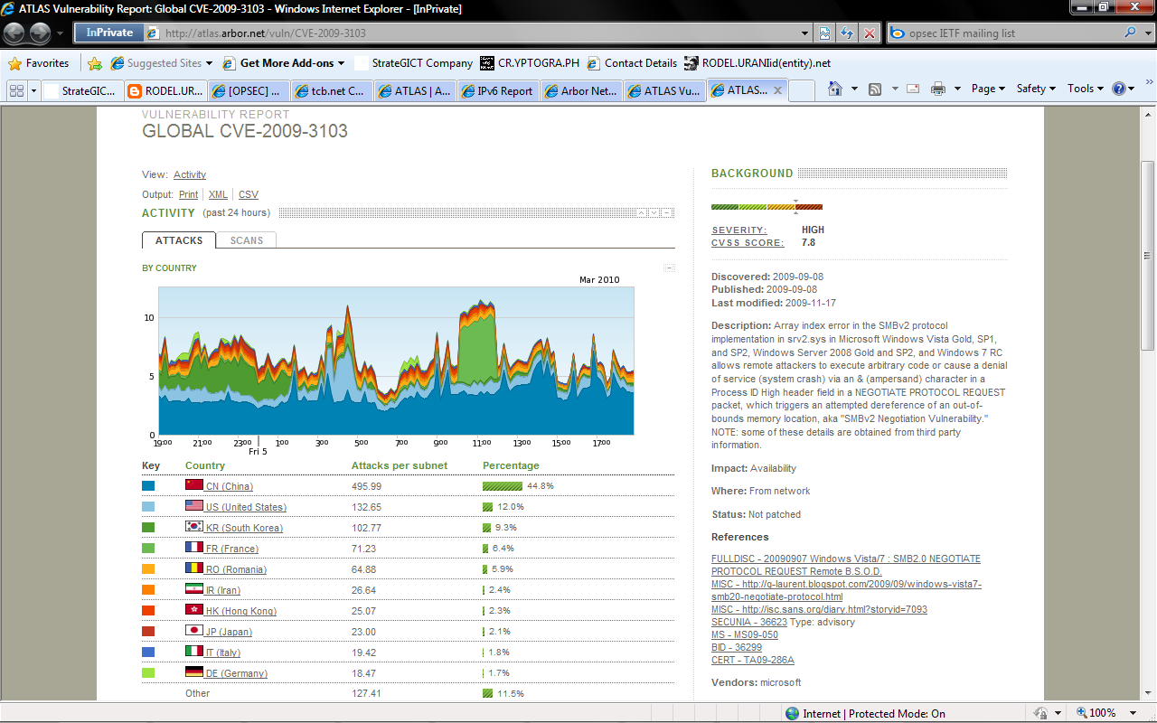
Vulnerability report, top scanned services
Source: Arbor Networks ATLAS Security Portal captured 7 Mar 2010 6:50A

Slide 12
Uses single core
Cyber security
Internet security
Information security
Systems security

Slide 13
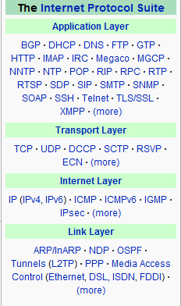
Real trend
TCP/IP

Slide 14
TCP/IP’s sad reality
Much efforts involve, can be really hard to improve or address security
Open standards implementation
Proprietary commercial grade
Institutions ongoing study for a better and secure internetworking experience
More attacks are developed and released daily
More cyber criminals in the loose?
Easier to create attack tools?

Slide 15
Plethora of resources on security
Security
Regulations, practices and certifications
Basel, PCI, SOX, ISMS, CISM, CISSP, CEH, Security+, policies, et al
Technology and attack tools
IPv4/6, IPSec, Firewall, PKI and Certificate (encryption and decryption keys) Authority (CA), network monitor, DDoS
Personnel
Practitioners
End-users

Slide 16
Security matters
We keep on saying we are secure!!!
Incidents in the not too distant past
Government’s majority, if not all, of information infrastructure and services, have been derailed / halted (how many days?)
Foreign top diplomat sent info via Internet to media altered
Internet company not immune to DoS
Worlds renowned security guru victim of scam

Slide 17
Review and tweak approaches
Security issue continues
In spite increasing sophistication of security technologies and practices
Security and IT-related efforts may need to involve stakeholders
Security!!!
Involves careful planning, design, operation and management on both physical and logical connection
Classify network type before dealing with access control
No interfaced in the global Internet
Think about: event and task, government, private sector, service provider

Slide 18
How do you concur?
UK Center for Protection of National Infrastructure (CPNI)
As a result, any system built in the future according to the official TCP/IP specifications might reincarnate security flaws that have already hit our communication systems in the past
Producing a secure TCP/IP implementation nowadays is a very difficult task partly because of no single document that can serve as a security roadmap for the protocols

Slide 19
Equation
Security of cyber space
Security of orbital space
Security of societies
Swedish Foreign Minister Carl Bildt

Slide 20
Checkpoint
How do you secure your network?
How do you achieve 100% security in your own network?
If possible, how?
If not, why? and
How do you address and mitigate it, at least to achieve 99.999%?

Slide 21
Sources and references
NATO chief calls attention to cyber threats
http://www.msnbc.msn.com/id/35709046/ns/technology_and_science-security
DHS threat level http://www.dhs.gov/files/programs/Copy_of_press_release_0046.shtm#0
Worldwide Infrastructure Security Report Volume 5, ATLAS Security Portal, available at Arbor Networks http://www.arbornetworks.com
Security assessment on IPv4 http://tools.ietf.org/pdf/draft-ietf-opsec-ip-security-02.pdf

Slide 22
STRATEGICT COMPANY Competitive business | Seamless technology
Thank you!
Q&A
RODEL@URANI.tel
|
ISSA Philippines Chapter, Inc
The Global Voice of Information Security Profession

